Slide 1


Slide 2
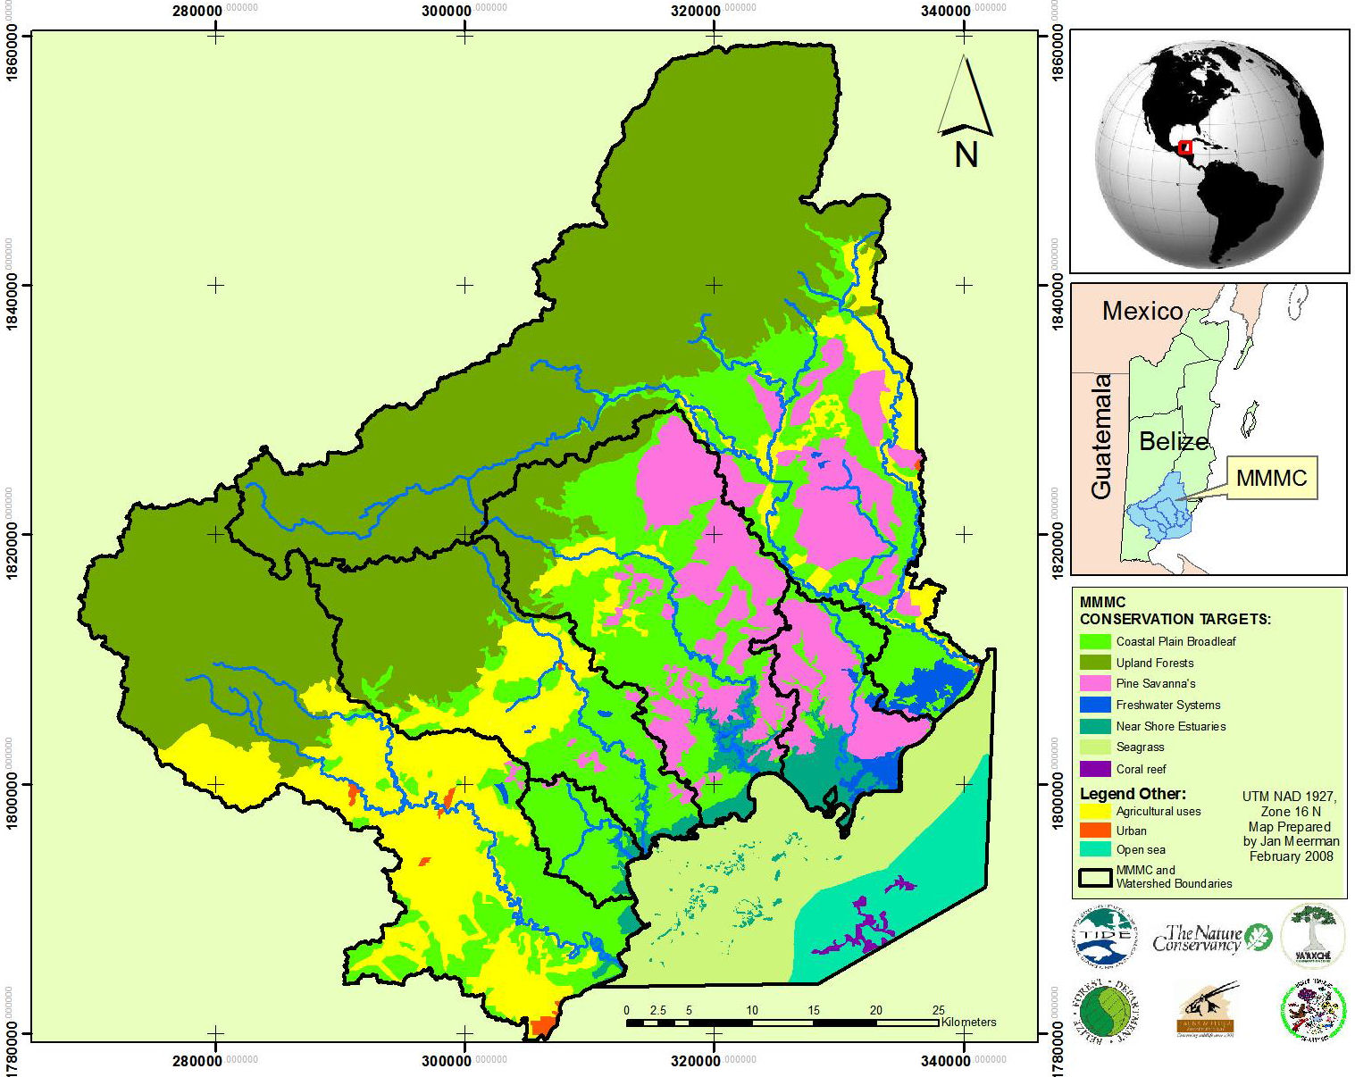
Maya Mountain Marine Corridor Conservation Targets

Slide 3
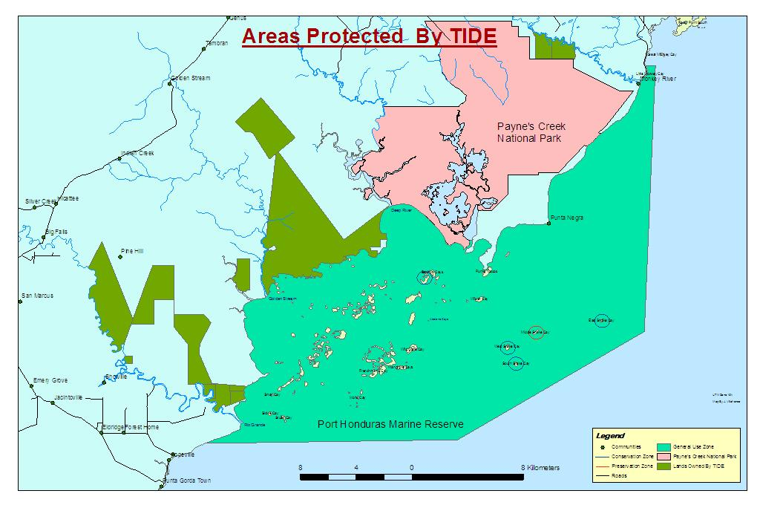

Slide 4
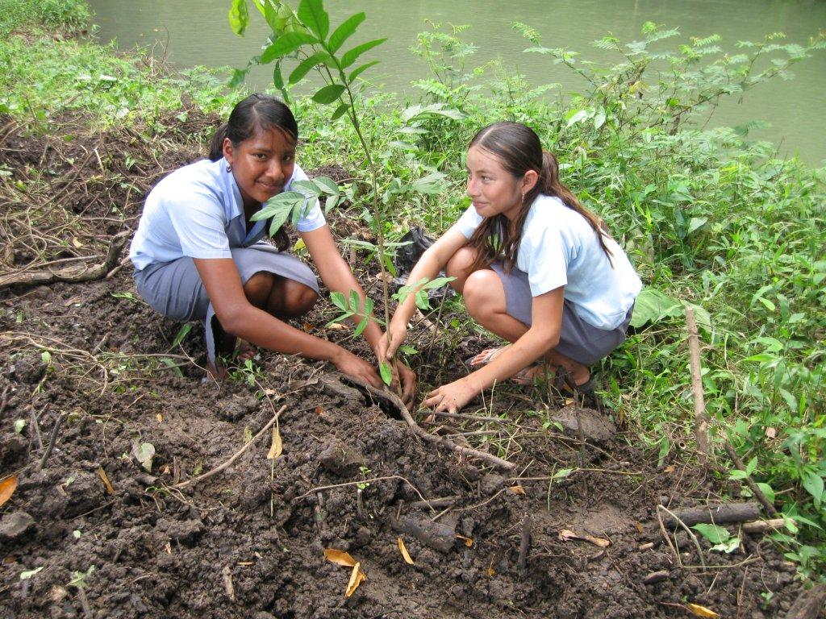
TIDE’s Mission
To foster community participation in ecosystems management and the sustainable use of resources within the MMMC of southern Belize for the benefit of current and future generations

Slide 5
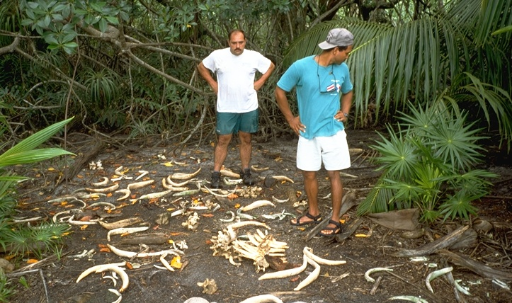
The beginning of TIDE
Notes:
5

Slide 6
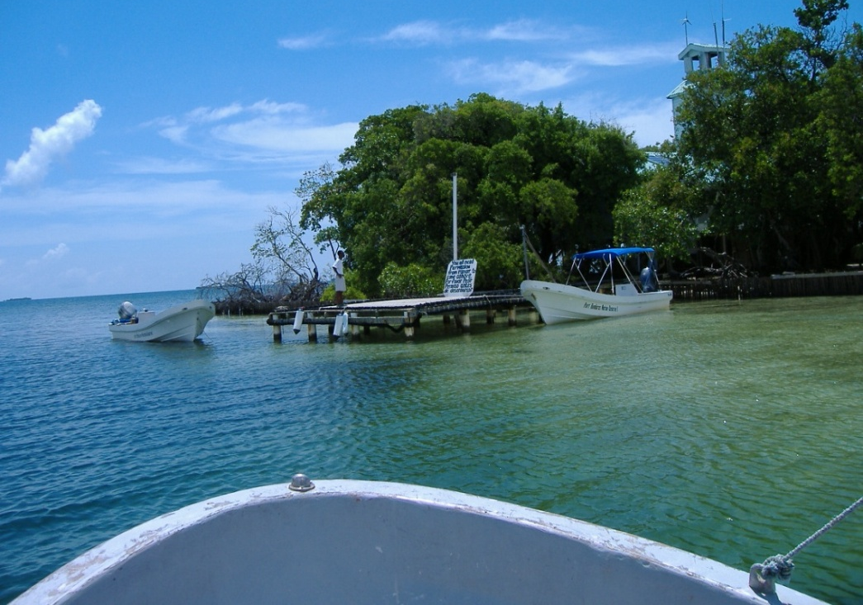
To protect and preserve marine resources for use by present and future generations.
Port Honduras Marine Reserve – 2000
Managed Access pilot site
Activities: Patrols,
research and monitoring
training, education and
outreach , recreation and
tourism services

Slide 7
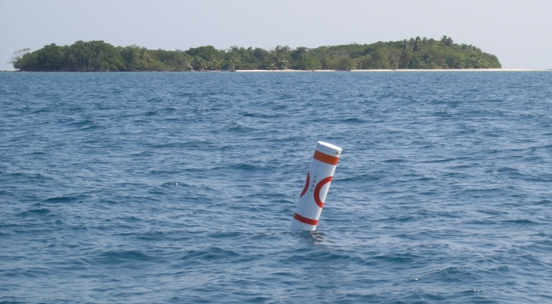
General Information
(Port (PHMR)
160 sq mls
138 mangrove islands
5 rivers empty into PHMR
Rio Grande
Deep River
Monkey River
Golden Stream
Middle River
2 villages border PHMR
Monkey River Village
Punta Negra Village
3 zones
General use zone
Conservation zones
Preservation zone
Demarcations Buoys used to show boundary
Notes:
Phmr is the size of barbados and has

Slide 8

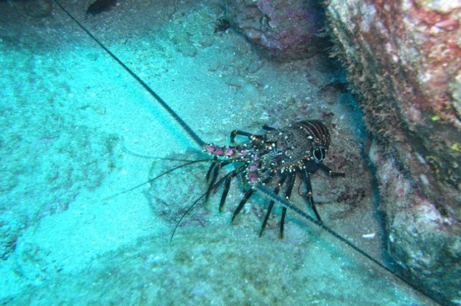
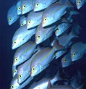
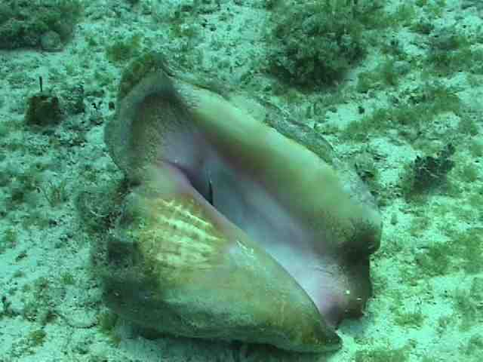

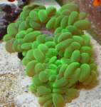
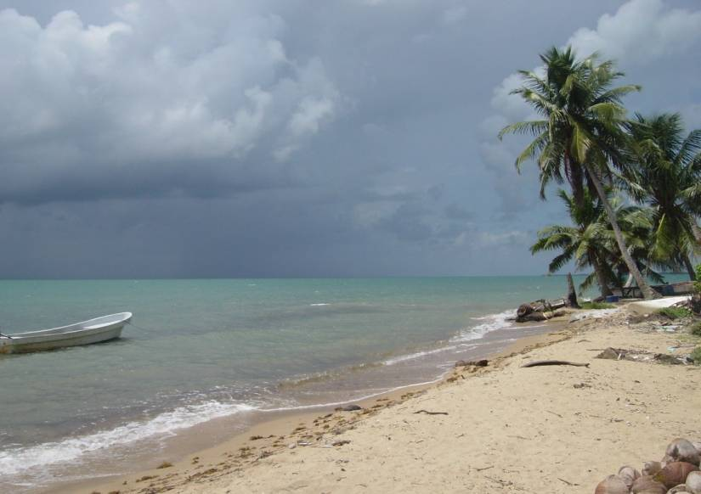
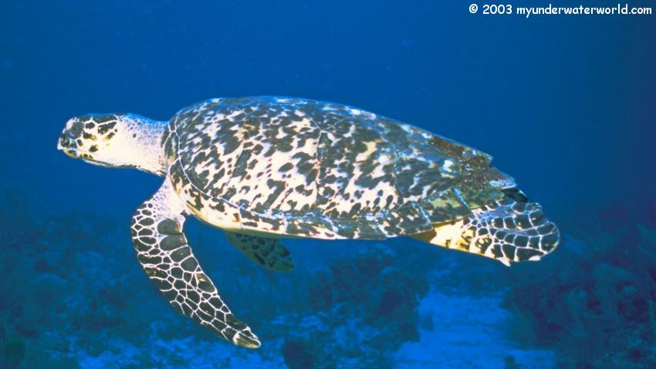
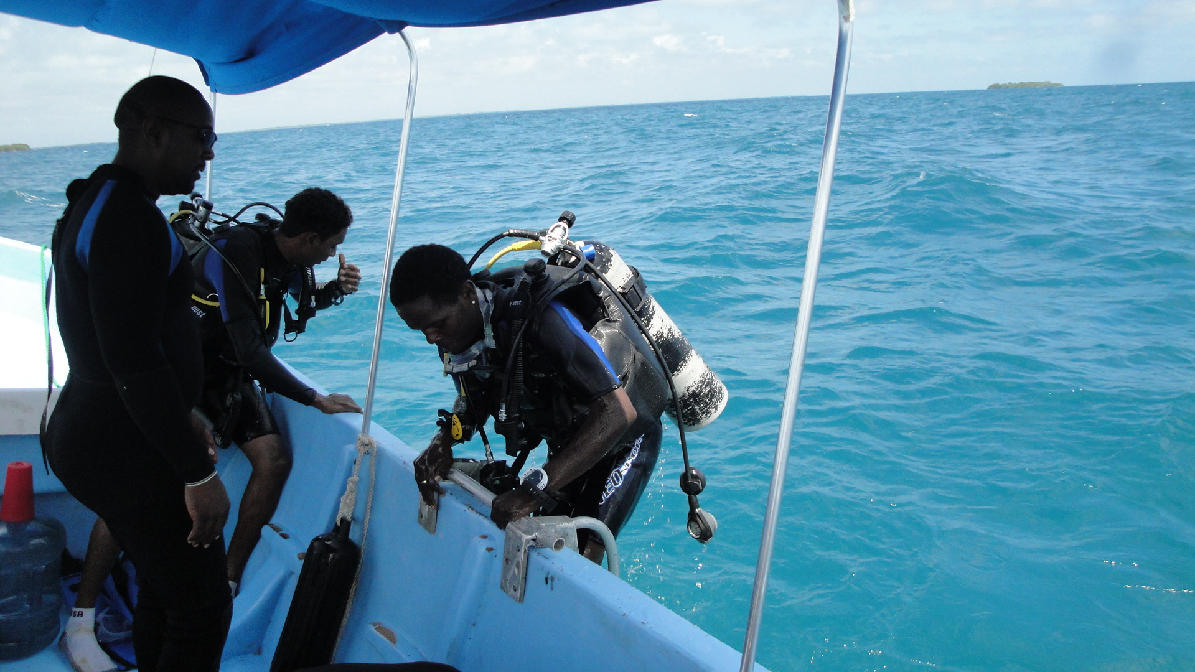
Research and Monitoring

Slide 9
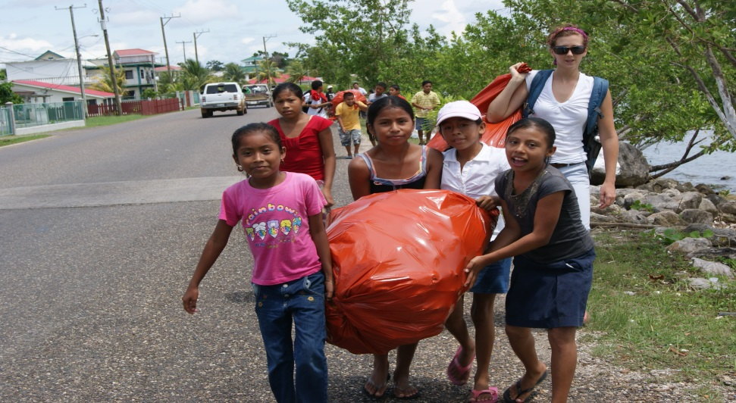
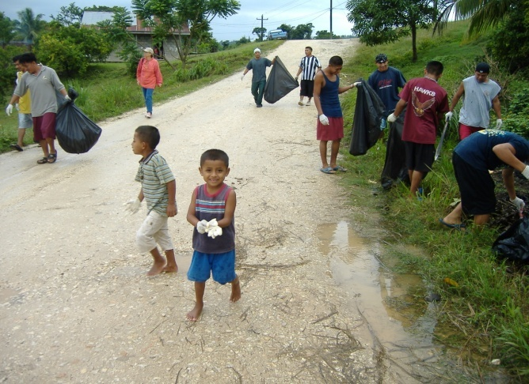
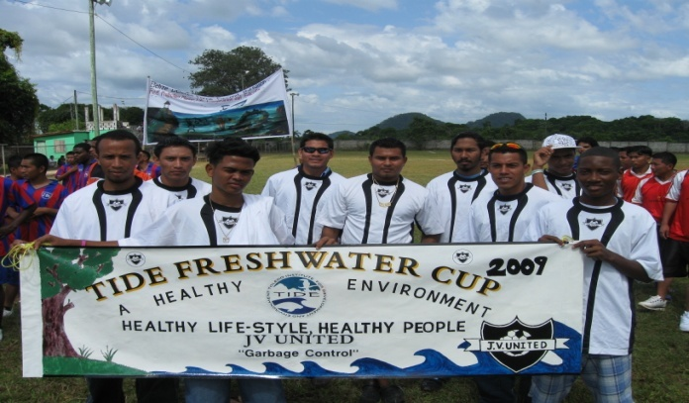
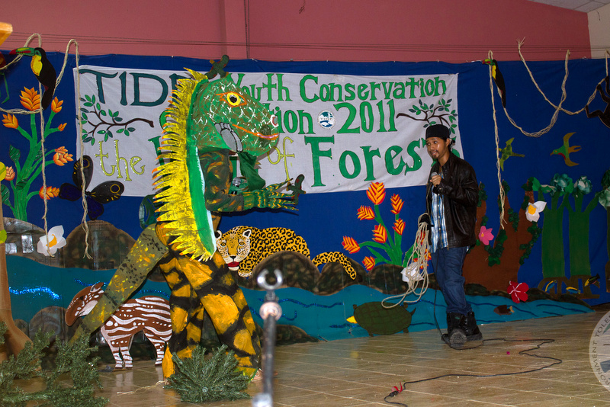
Education and Outreach

Slide 10
CLOSED SEASONS IN PHMR
Conch…… July 1 – Sept. 30
Shrimp….. April 15 – Aug. 14
Lobster..… Feb. 15 - June 14
Hicatee..… May 1 – May 31

Slide 11
Critical Threats
Illegal and over-fishing
Industrial agriculture
Shrimp Farming
Oil exploration
Climate Change
Pollution
Notes:
11

Slide 12
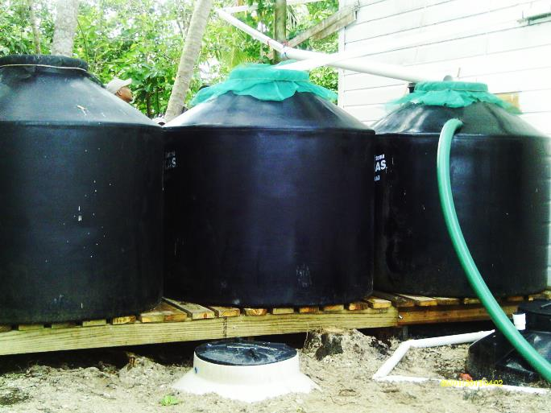
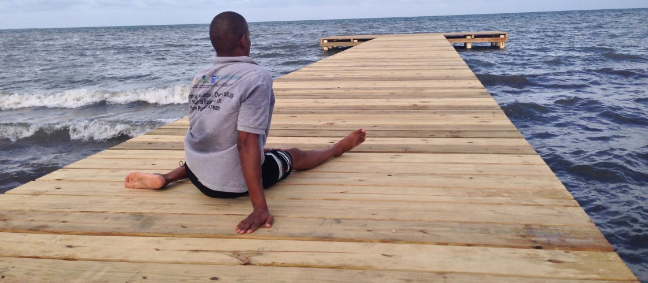
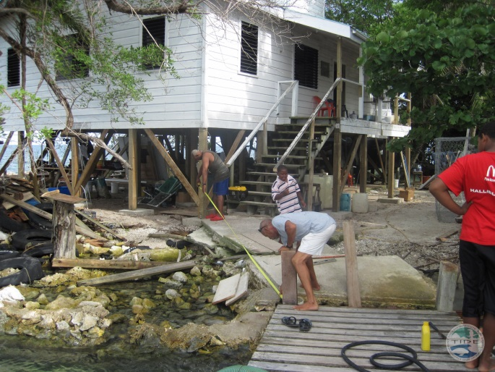
PRINCIPAL ACCOMPLISHMENTS UNDER THE KfW PROJECT Sept 2012 to June 2013
Investment in Infrastructure
  Construction of
compost toilet at Abalone Caye
  Repair TIDE Dock
  Repair docking facility at
  Abalone Caye ranger station
  Repairs to ranger station at Abalone Caye
  Signs for marine reserve

Slide 13
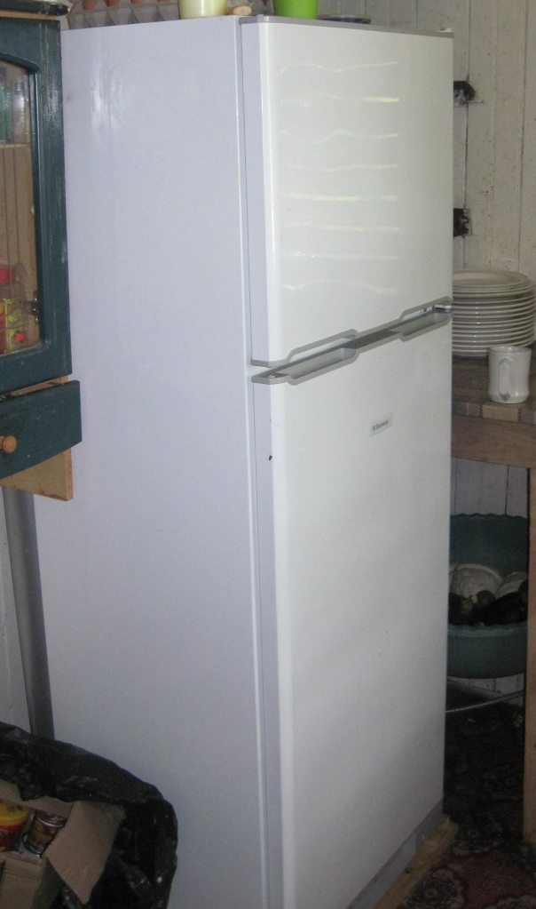
PRINCIPAL ACCOMPLISHMENTS UNDER THE KfW PROJECT Sept 2012 to June 2013
Investment in Equipment
  First aid kits for PHMR rangers
  2 boat engines and repair kit
  for bilge pump for patrol and research
  boats
  New kit to service dive equipment
  Uniforms kits for PHMR rangers
  Demarcation kits for PHMR
  Laptop computers
  Gas refrigerator

Slide 14
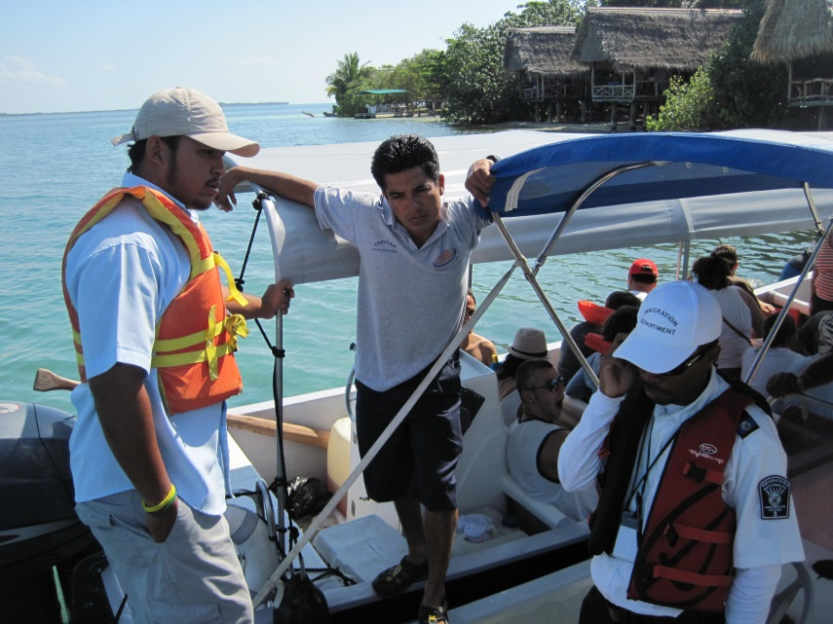
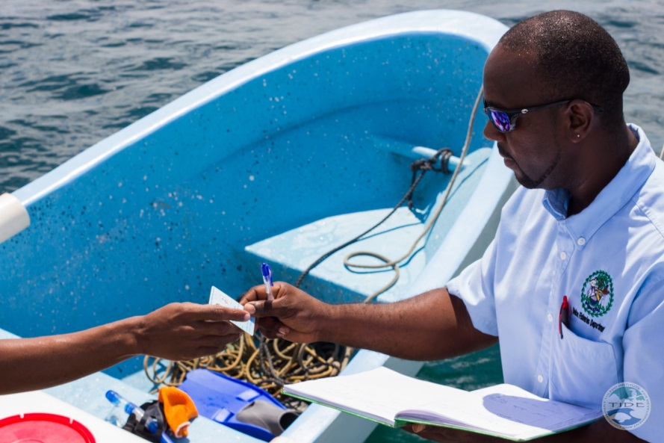
PRINCIPAL ACCOMPLISHMENTS UNDER THE KfW PROJECT Sept 2012 to June 2013
Support for implementation of the control and surveillance system
  Surveillance and patrols – over 700 patrols resulting in 9 written warnings issued to fishers and other users conducting various degrees of illegal activities

Slide 15
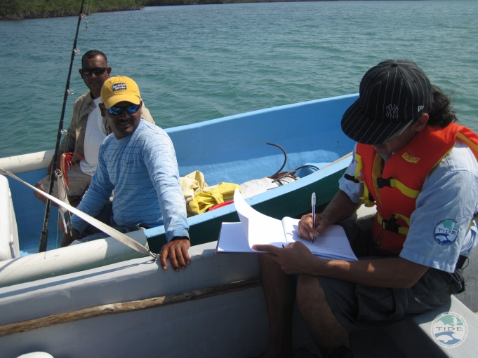
PRINCIPAL ACCOMPLISHMENTS UNDER THE KfW PROJECT Sept 2012 to June 2013
Support for implementation of the control and surveillance system
  First aid training for PHMR rangers
  Law enforcement training for PHMR rangers – All TIDE rangers and some rangers from another NGO participated 14 rangers total.
  Boat navigation and boat engine maintenance training for rangers

Slide 16
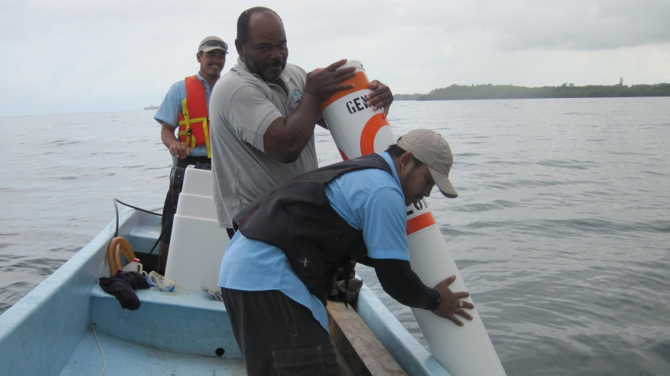
PRINCIPAL ACCOMPLISHMENTS UNDER THE KfW PROJECT Sept 2012 to June 2013
Protection of fragile ecosystems
  Complete the demarcation of PHMR – purchased 30 demarcation buoys, installed 6 in the general use zone and work is on-going. Waiting on the approval of the new replenishment zone before installing buoys in this area.

Slide 17
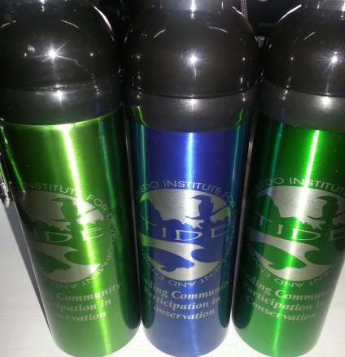
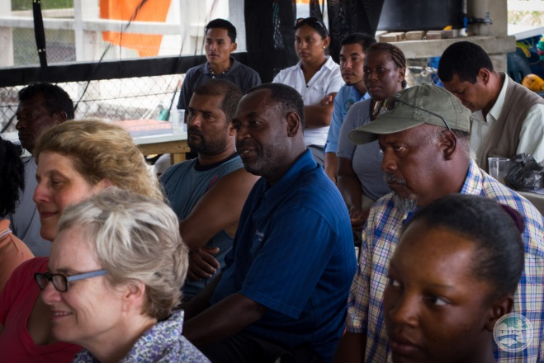
PRINCIPAL ACCOMPLISHMENTS UNDER THE KfW PROJECT Sept 2012 to June 2013
Institutional Strengthening for Area Managers
  Official launch of the KFW Project in Belize
    Completed attended by key individuals from Government of Belize, media and other NGOs
  Implementation of communication strategy for TIDE
    On-going, 100 water bottles printed, 100 caps in printing.

Slide 18
PRINCIPAL ACCOMPLISHMENTS UNDER THE KfW PROJECT Sept 2012 to June 2013
Development of the productive fabric of communities/associations
  Conduct a feasibility study of a business enterprise for Punta Negra and develop a business plan for the enterprise.
    Consultant secured, work started in July 2013.

Slide 19
PRINCIPAL ACCOMPLISHMENTS UNDER THE KfW PROJECT Sept 2012 to June 2013
Involvement of organized community groups in the management of natural resources.
  Field visit to PHMR for school children in 2012 - Completed
  Implementation of communication strategy for TIDE – Completed for 2012 investments made in equipment for Information Technology.
  Support 15 participants from PHMR to attend the fourth Tri-national Fishermen Forum in Honduras - Completed in 2013 in Honduras, 10 participants attended.

Slide 20
PRINCIPAL ACCOMPLISHMENTS UNDER THE KfW PROJECT Sept 2012 to June 2013
Involvement of organized community groups in the management of natural resources.
  Networking - PHMR advisory council meetings, APAMO, Coral Reef Network, TRIGOH, SPAGs, etc – On going, attended Coral Reef Network meetings.
  4 Field visits to PHMR for school children in 2013 – 2 visits completed, over 40 students visited the marine reserve from 2 visits. Additional visits planned for September and October 2013
  Dive training for 9 community researchers - Completed
  Support 15 participants from PHMR to attend the festival of the sea in Guatemala – Completed, 10 participants attended

Slide 21
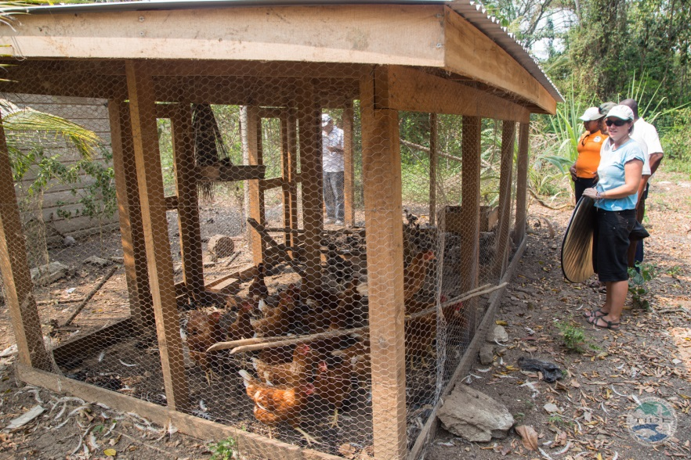
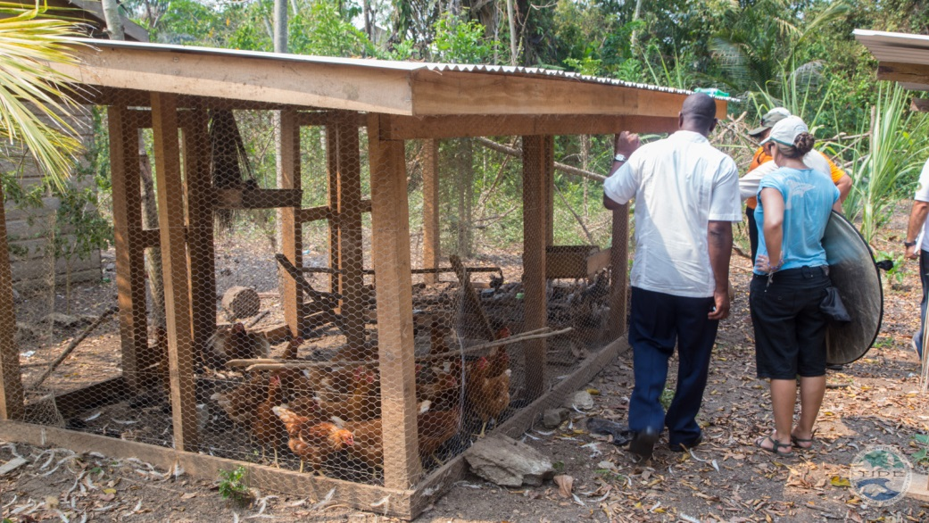
PRINCIPAL ACCOMPLISHMENTS UNDER THE KfW PROJECT Sept 2012 to June 2013
strengthening of community/associations
  Support supplemental livelihood projects for Toledo and Monkey River Fishermen Associations – Completed; a total of 17 fishers benefitted from this project. 7 fishers benefitted under this project.

Slide 22
Lessons learnt from project
PLANNING
  Need to have long term planning documents for organization to adequately benefit from this project.
  In-depth planning assisted with project implementation
COMMUNICATION
  This project helped with strengthening communication between partners, but requires constant communication.
MANAGEMENT/IMPLEMENTATION
  Use of MAR Fin tool in Protected Areas management
  Needs a fulltime project manager

Slide 23
Lessons learnt from project
FINANCE
    Use of ‘Comparison table’ developed by the project can be adopted by the organization
    Use of Financial gap analysis tool for long term planning

Slide 24
Challenges encountered during implementation of project Sept 2012 to June 2013
  Timely disbursements of funds especially at the beginning of the AWP.
  AWP guidelines needed to be strengthened to ensure partners are fully aware of exactly what the project can and cannot fund.
  Reporting frequency
  Financial gap required that organizations have a detailed 10-year work plan and budget. Our planning documents are normally done for a 5-year period.
  Turn around time on feedback for AWP and reports is too long.
  Needed training on how to complete financial reporting forms (English).

Slide 25
Challenges encountered during implementation of project Sept 2012 to June 2013
  Online financial reporting system had some issues. These types of systems should be tested thoroughly before release.
  Inventory of assets need to be separate (TIDE and Community). Investments in the communities are not considered TIDE owned.
  Language barrier
  The project has very high administrative costs and it needs to fund some percentage of that cost.
  Constant and sudden changes to operational procedures

Slide 26
Recommendations for problems encountered during implementation of project
  PACT and TIDE should hold a workshop to finalize the AWP before sending to MAR Fund. This will decrease the turn-around time between TIDE and PACT.
  As this is a regional project, all partners need to visit all project sites to better appreciate the regional scope of the project.

Slide 27
COMMUNITY DEVELOPMENT PLANS
  The communities of Punta Gorda and Monkey River have community development plans that will be updated under this project by the end of 2013.
  An outline of the community development plan for Punta Negra is available and will be further developed during this project.

Slide 28
Some ideas for 2014 AOP (Need to be developed further)
  Invest in large boat and boat trailer for patrols (Such as Sea Force 730 LE)
  Invest in sub-station on West Snake Caye
  Training for rangers on use of boat, special law enforcement, boarding procedures, navigation etc.
  Invest in Abalone caye restoration to complete the work.
  Implementation of community development plans
  Implementation of alternative livelihood enterprises based on feasibility study and business plan
  Implementation of Tourism product development and marketing based on those two plans for communities.

Slide 29
Some ideas for 2014 AOP (Need to be developed further)
  Investment in TIDE Board and Advisory Council development.
  Investment in financial sustainability programs for TIDE such as Ridge to Reef volunteer program.
  Exploration of additional financial sustainability programs for TIDE.
  Support special research projects in the marine reserve such as conch lip-thickness and maturity.
  Investment in Managed Access fisheries management program (fishing forums, training, data reporting etc)
  Strengthen organized community groups such as fisherman associations, cooperatives, fisherwoman associations, etc.

Slide 30
Some ideas for 2014 AOP (Need to be developed further)
  Invest in special training for community researchers (SCUBA diving and marine monitoring programs)
  Invest in special training for Community Stewards
  Equipment for rangers such as flashlights, raincoats, GPS, marine footwear etc)
  Revision of PHMR Statutory Instrument to ensure mangrove islands are included in the reserve.
  Address recreational and sport fishing to ensure sustainability.

Slide 31
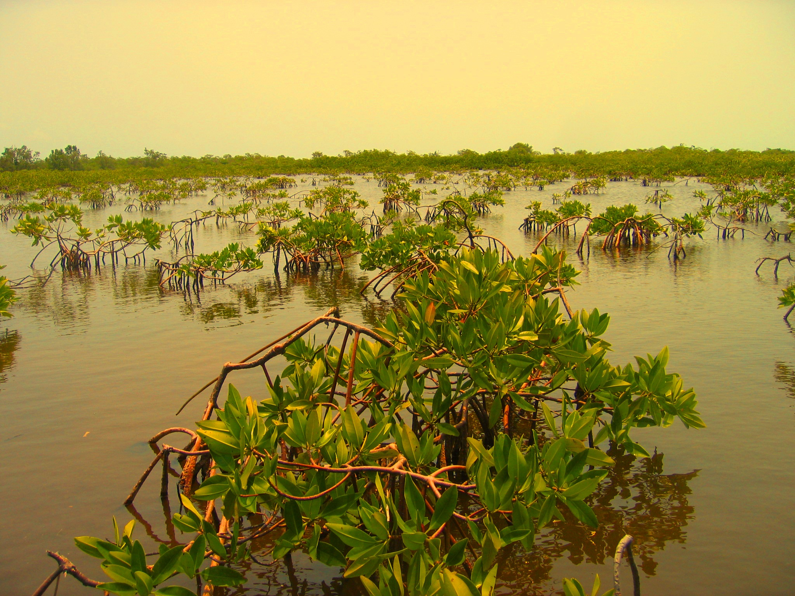
TIDE
Fisheries Health Assessment
PHMR 2009-2012

Slide 39
Conch Conclusions: shell lengths
% conch fished population in middle size (20-25cm) increased over last 3 years, while % fished conch population in upper size class has dropped from almost 45% in 2009 to 3% in 2012!
What’s staying in the water is getting younger, and what is coming out is becoming increasingly restricted to one size category (20-25cm), with megaspawners being less % of catch than 3 years ago, to less than 20% threshold.

Slide 44
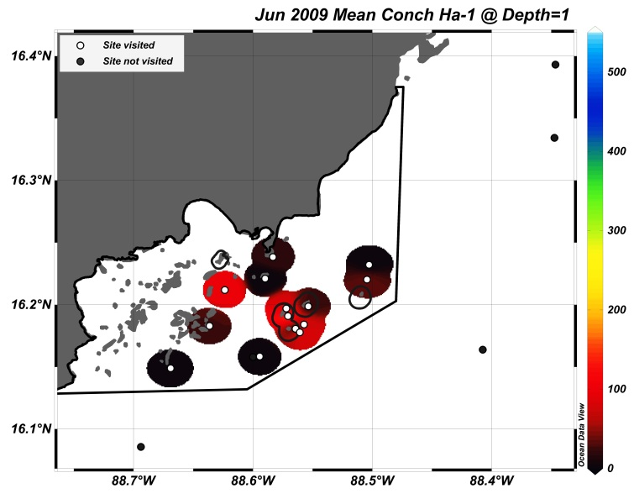
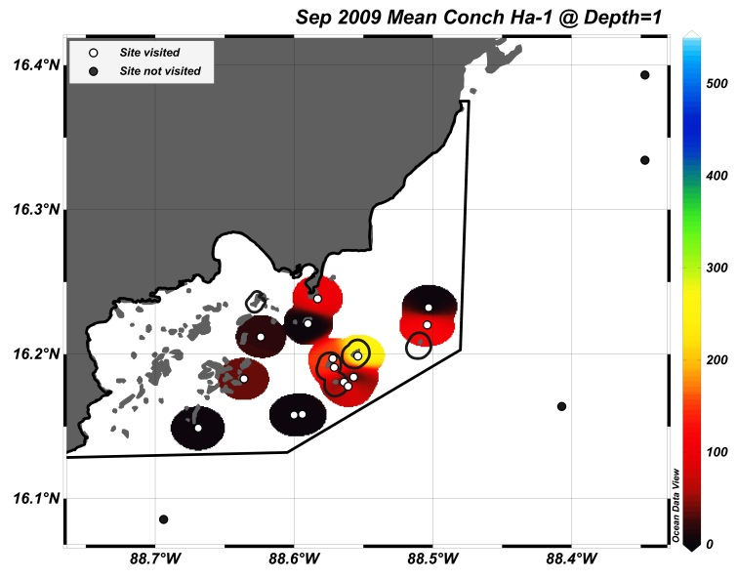
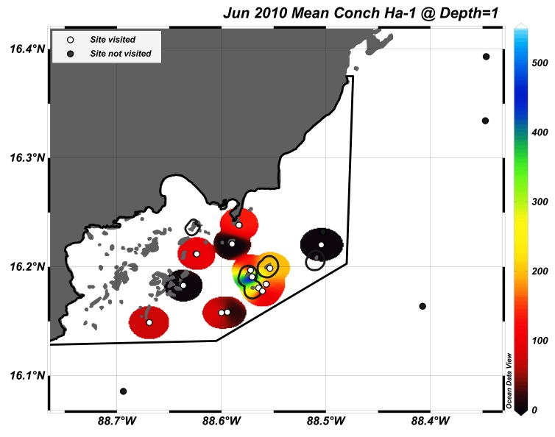
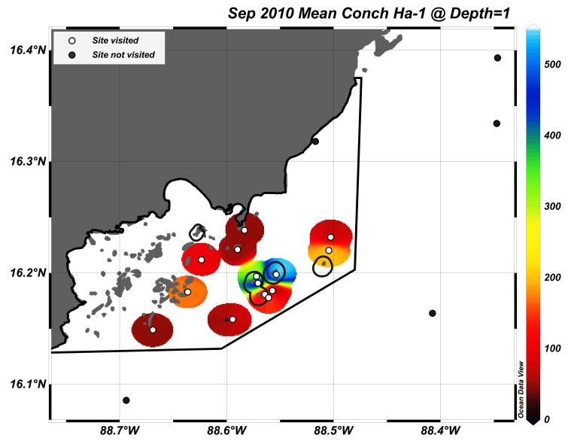

Slide 45
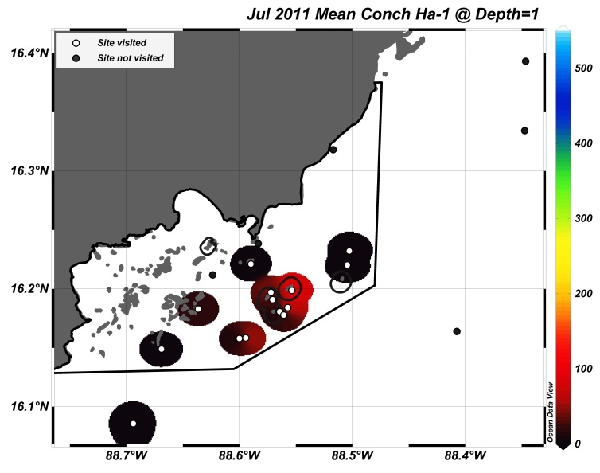
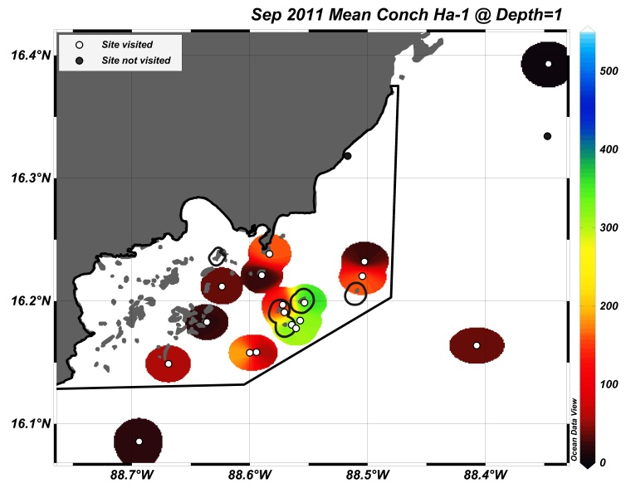
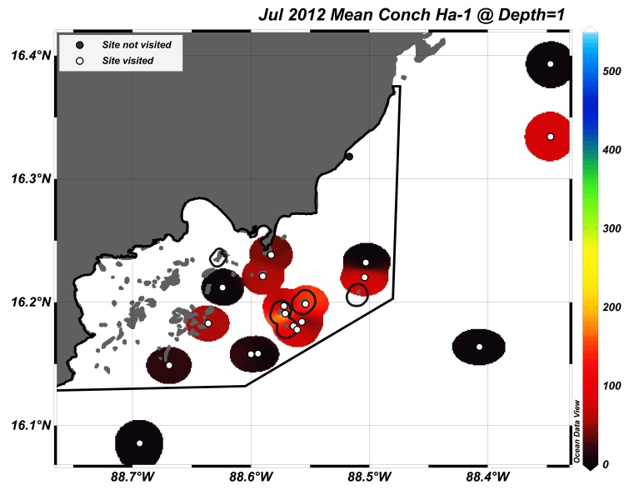
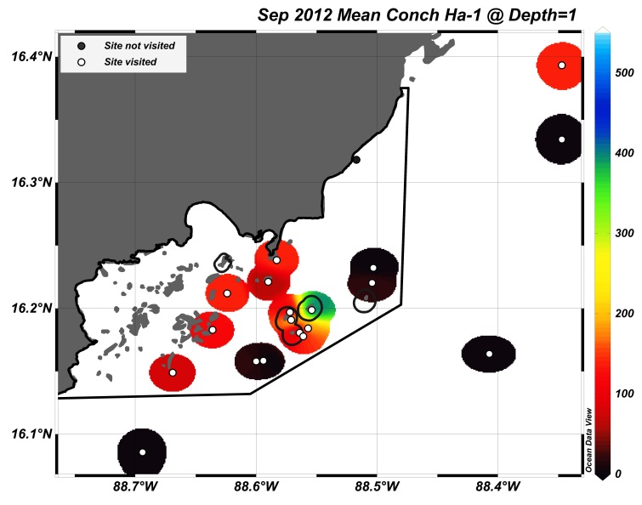
First monitoring since Managed Access

